Slide 2
The Hidden Cost of Malicious Emails: Time
John Phil, Senior Solutions Architect, SonicWall
Notes:
Welcome to The Hidden cost of Malicious Emails
My name
Submit questions via BrightTalk, we’ll have a Q&A session at the end

Slide 3
Agenda
Why this study
The results
Next steps
Notes:
here's our brief agenda
We’ll dig into Challenges in Email security and its management.. Talk a bit about the methodology
But the real focus is what we learned from our results, and how that can be applied

Slide 4
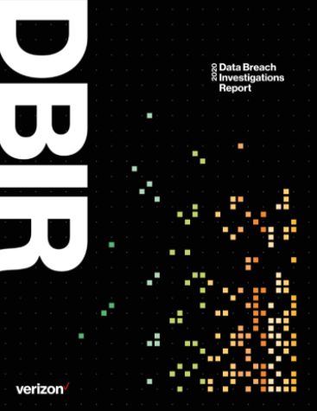
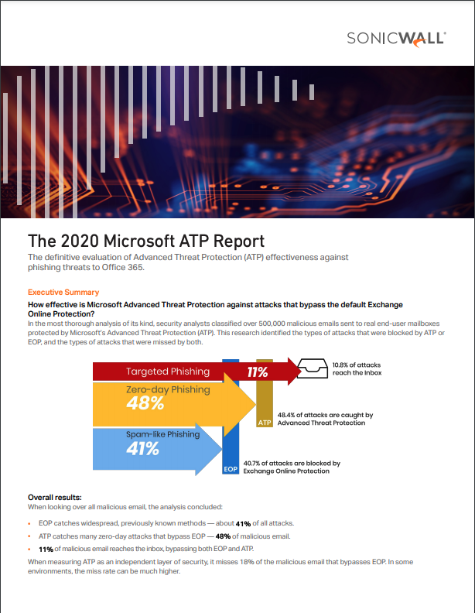
The Hidden Problem With Email Security
Email is #1 threat that results in breaches
Over 90% of breaches start with Email
Office 365 is the most targeted Business Application
Microsoft tools (both EOP and ATP) miss a significant number of attacks
The Hidden Problem is the Email Security Operations Burden
Notes:
Microsoft misses targeted attacks.
Dive into the burden… IT overload

Slide 5
Why This Study
Phishing is an immense problem
Financial and reputation loss
Losses of time are less quantifiable and more elusive
Notes:
Phishing is huge… given
Financial loss… also given
The loss of time is the main focus. End user, Helpdesk & SOC
Initial research led us to Gartner

Slide 6
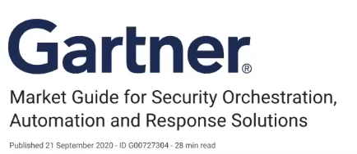
Gartner’s Take On It
“The most common use case [for SOAR], is automating the triage of suspected phishing emails reported by end users”
“This is a process that follows a repeatable process, dozens to hundreds of times per day”
“It is a process ripe for the application of automation”
Notes:
Gartner began to address the lost time associated with phishing in late 2020 when they wrote a market guide for Security Orchestration Automation and Response solutions.
Comes into play with IT’s response to and the additional burden placed on IT/SOC/Helpdesk

Slide 7
POLL #1
Do You Currently Use 3rd Party Email Security?
Yes, In front of an On-Prem solution.
Yes, In front of a Cloud SaaS solution.
No, Only what the SaaS offers.

Slide 8
About The Survey
Understand the magnitude of time associated with effectively managing the Email Threat
Over 500 IT leaders
Prevention
Response
Investigation

Slide 9
Definitions
Prevention
Any activity that aids in the configuration and management of email security to prevent attacks from reaching end-user inboxes.
Prevention
Including:
Tasks such as updating allow/block lists
Creating new mail flow rules to block specific domains
Updating ATP policies
Response
Investigation
Notes:
How much time on prevention-based tasks

Slide 10
Definitions
Investigation
Any manual steps taken to decide if an email is malicious or benign.
Prevention
Including:
Researching email headers
Determining which links were clicked
Identifying compromised accounts and leaked data
Response
Investigation
Notes:
WHO has been compromised, WHAT got out

Slide 11
Definitions
Response
Any activity after a phishing email is delivered to the end user.
Prevention
Including:
Resetting licenses
Resetting credentials
Calling end users
Conducting a post-mortem
Response
Investigation
Notes:
Once you realize that a phishing campaign has been successful, and you need to take action.
After the malicious payloads have been delivered, after the links have been clicked, after malicious content has been downloaded, after the organization has been compromised
What does the org do?
Call people, revoke licenses, etc those types of tasks

Slide 12
High Level Findings
Average SOC spends almost 23% of their time dealing with the email threat:
Response: 26.6%
Prevention: 26.5%
Investigation: 46.9%
Attackers are still reaching end users in record numbers.
Response
26.6%
Prevention
26.5%
Investigation
46.9%

Slide 13
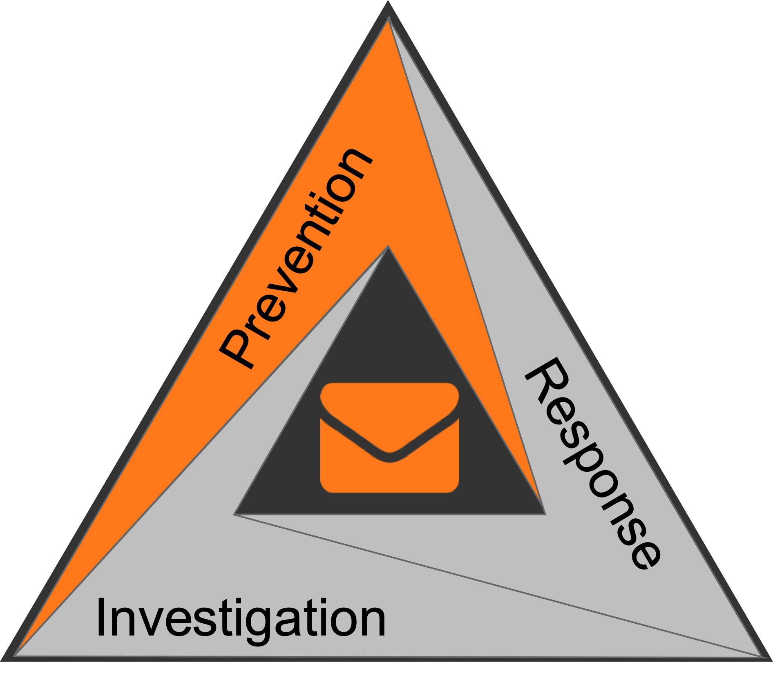
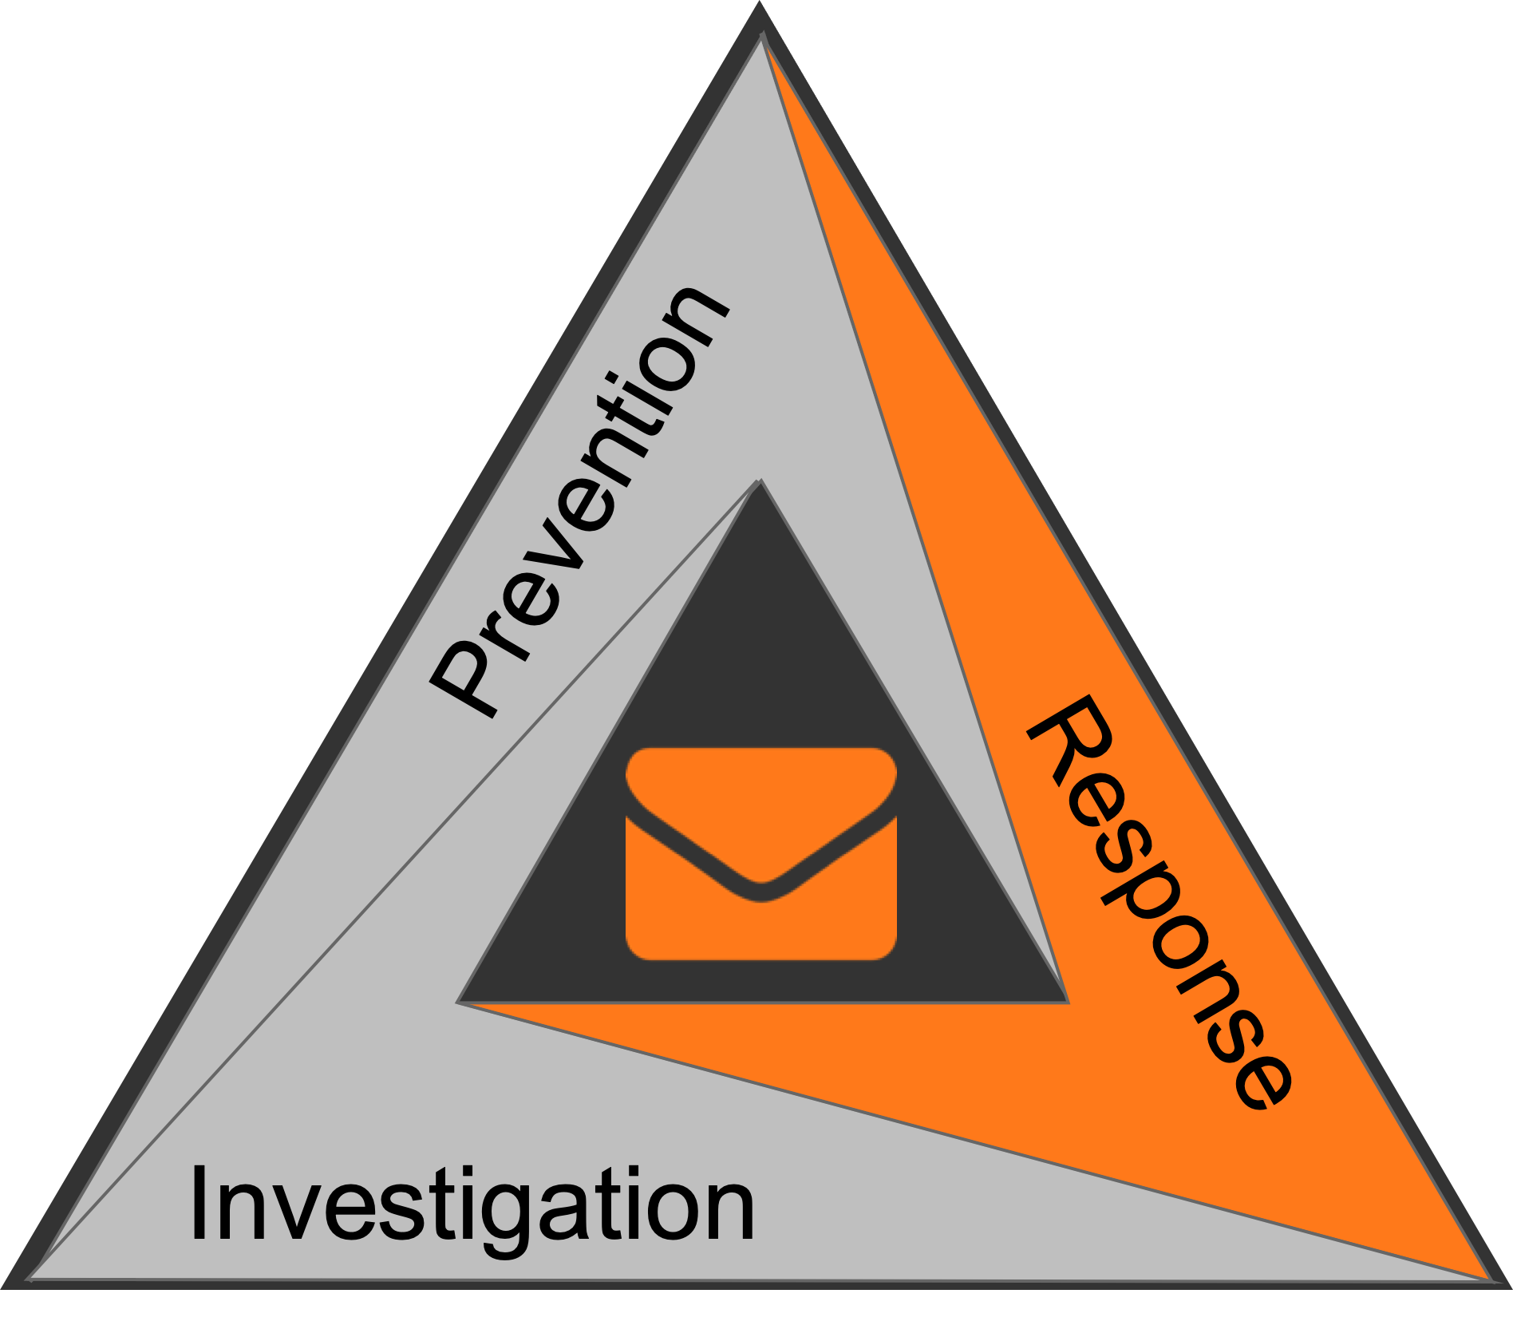
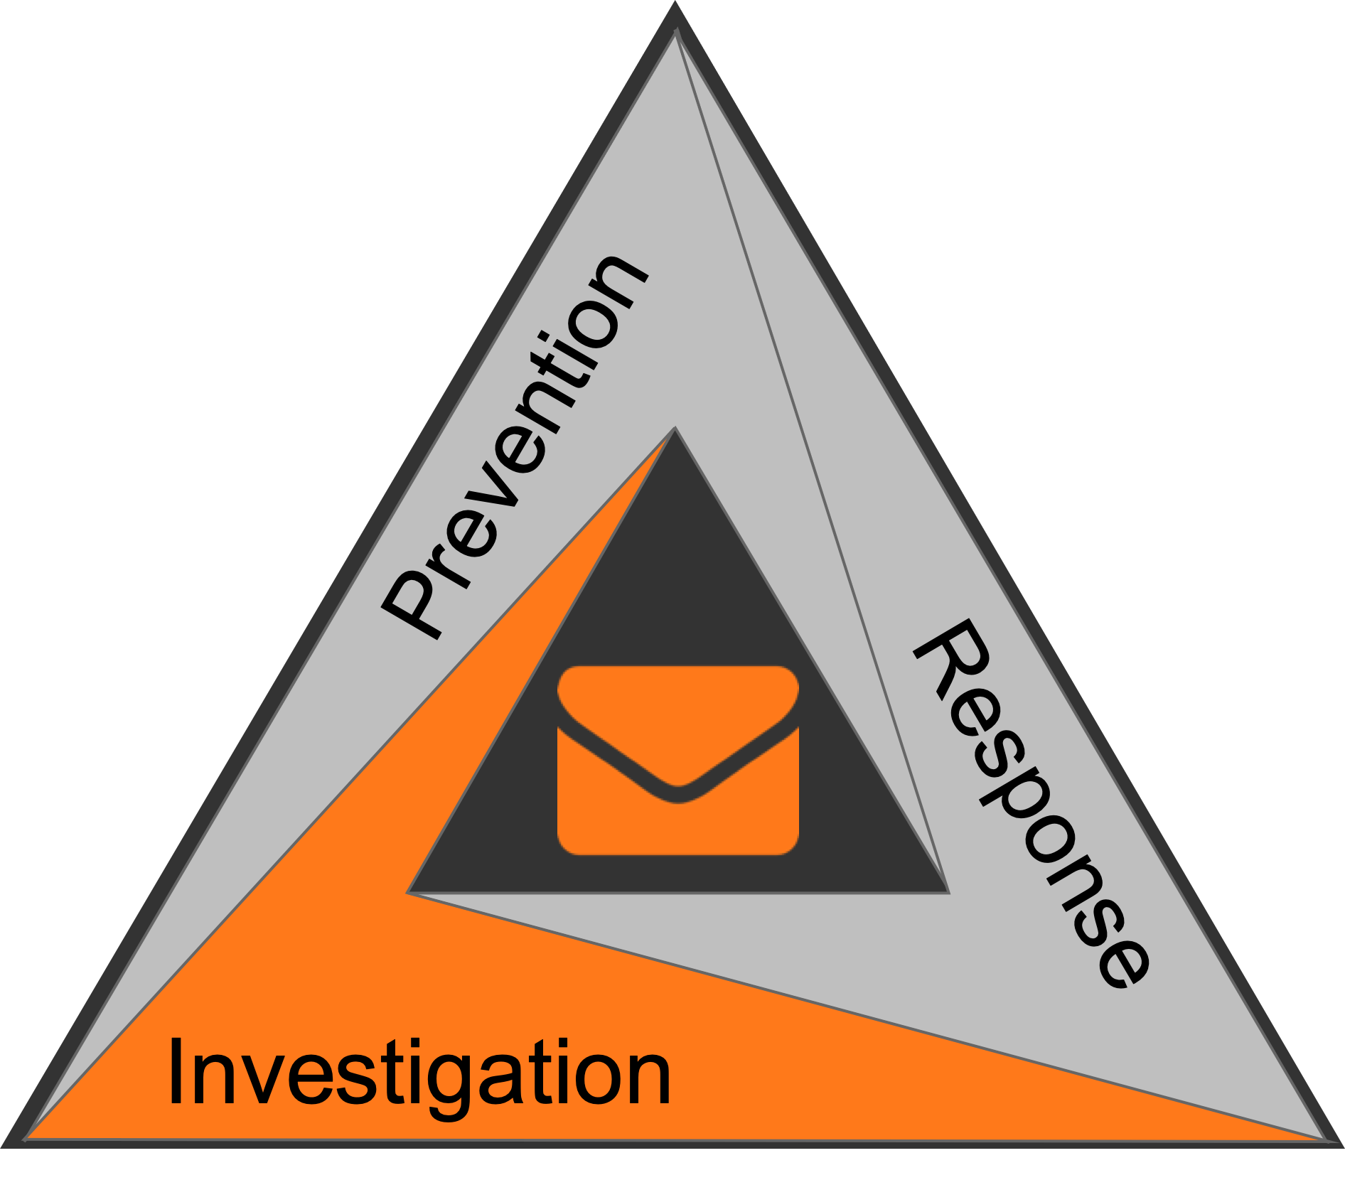
Prevention
Prevention
Prevention
Prevention
Response
Investigation
Response
Response
Investigation
Investigation

Slide 14
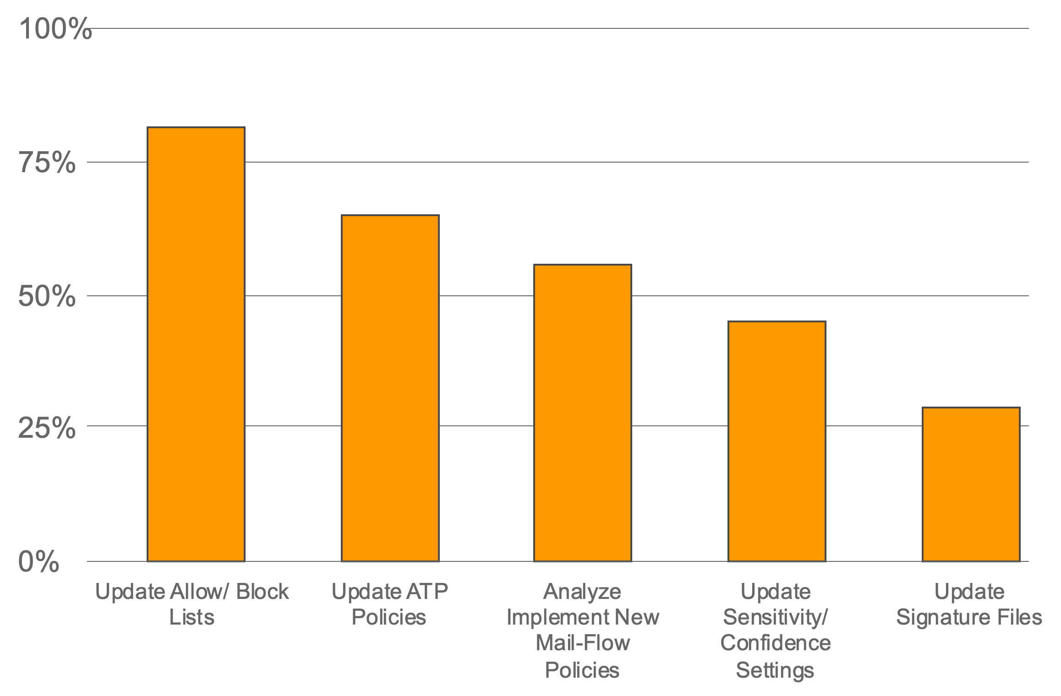
Percent if Respondents vs Prevention Task
More than ½ of the respondents perform these tasks to help prevent future attacks
Update Allow/Block lists
Update ATP policies
Implement new Mail-Flow Rules
Notes:
The playbook on managing the Email threat is very similar around IT departments
Half of the respondents came back with the same three tasks that they routinely performed…
1- Update the allow or Block lists as you would expect
2- For those that have it, updating Microsoft ATP policies.
3- this one was the most surprising to me… Implementing new Mail Flow rules… a rudimentary approach
I talked to one organization that uses this approach, and their response was that they don’t have AI… They have Joe, and he does what he can, but it is a very reactive approach, that often takes a few refinements to get right, consuming IT time, and wasting end user cycles as they continue to report the same phishing campaign. We pride ourselves on our AI, which allows you to avoid this blackhole.

Slide 15
Investigation
Notes:
Investigation accounts for almost ½ of the time spent managing the Email threat. This can be broken down into 2 buckets.

Slide 16
Investigation: The Two Halves
End User Reported Phishing Alerts
Release From Quarantine Requests
False Negatives
False Positives
Notes:
End User reported Phishing alerts…” If you see something, Say something” These are the notifications, either by email, or a button in the app that users can ask or report if this email is a phishing attempt.. These go to the SOC or IT … someone needs to look into each of these and investigate, adding to their workload
The other part of it is requests from users to release messages from quarantine that the security solution.
These are false positives and false negatives

Slide 17
POLL #2
Do Your Users Report Suspected Phishing?
Yes, Clicks on button in browser/agent.
Yes, Forwards email to admin.
No.

Slide 18
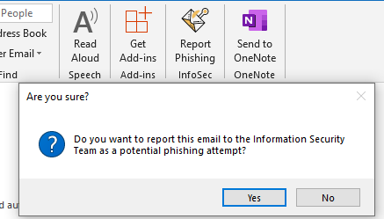
Investigation: End User Alerts
Do Your Users Report Suspected Phishing?
43%
Yes. Forwards
email to admin
Report Phishing
Notes:
89% of orgs have a process to report phishing. Both Microsoft 365 and Google have native tools built into report suspected phishing emails
11% don’t have that capability.
Embedded button in the browser or agent. Or less sophisticated approach of forwarding the email

Slide 19
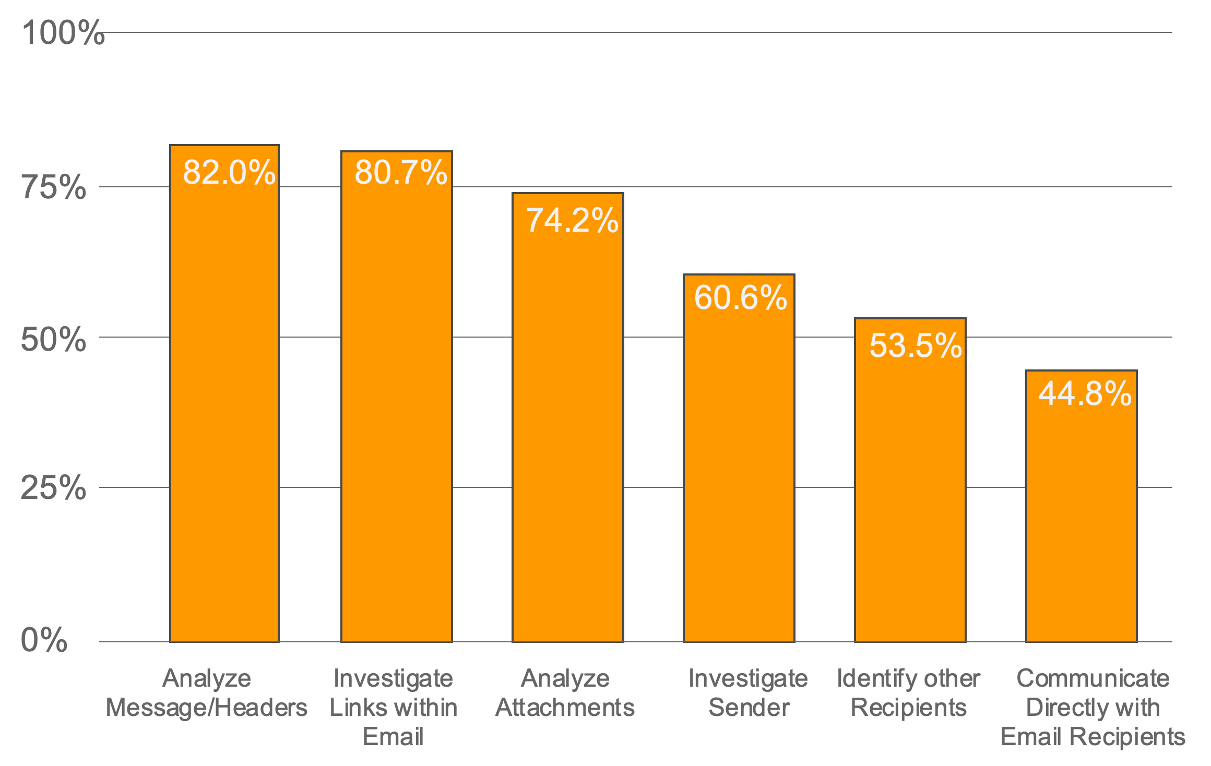
Investigation: End User Alerts
Investigation requires:
Multiple Steps
Multiple Tools
Report Phishing
Notes:
Analyze Message headers is a time consuming process when manually done, looking into the IP address and even geo location of where the email came from, seeing if it was a web based client, or an application. Ensuring that the date makes sense and that all of the embedded information cross checks and makes sense
Investigate links within the email… are the links known to host malware? Is the content appropriate, are they hosted on a SaaS platform like Microsoft or google?
Analyze attachments… by running hashes through Online repositories of malware like VirusTotal, or even running the files through a sandbox, either in the cloud or on-prem
Investigate the sender… is there an established relationship with that user or organization?
ID other recipients… did everyone in the org get the same alarming, time sensitive email?
Communicate directly with the recipients…. On the phone or in person, discuss the email, was it expected, can they add any color to the investigation?

Slide 20
Investigation: End User Alerts
Fueled by phishing awareness training and corporate policies
SOCs receive almost 69 end user reports per week based on the survey
On Average, it takes 7.7 minutes of inspection for each email
33.8 turn out to be malicious
Many are slipping through, and remediation requires much more effort
Report Phishing
Notes:
Phishing training is a standard Federal, NIST 800-53, FISMA, Corp policies
Those 69 weekly end user reports varied greatly based on organization and corporate culture, but on average for the study there were 68.7 reports each week that needed to be addresses.
Each report took the SOC approximately 7.7 minutes to resolve. Turns out 33.8% of the reports were malicious.
Lots of malicious emails are getting through the defenses, and they all require a significant effort to deal with.
Is the IT time being used wisely?

Slide 21
POLL #3
Can Your Users Request to Restore Email from Quarantine?
Yes, Sends an email to an Admin.
Yes, Embedded action within the quarantine alert.
No.

Slide 22
Investigation: Release From Quarantine Requests
16 Restore requests per week
30.7% released because of false positives
10%
No
32%
Yes - Send an email to the admin
With SonicWall CAS
Restore requests per week: 2.7
False positive rate: 0.56%
58%
Yes - Embedded action within the quarantine alert
Report Phishing
Notes:
90% of the organizations have a process in place to allow users to release a quarantined email.
From formal processes embedded in tools, or a summary report to less formal Emails to IT to look for emails that should have arrived but aren’t there
10% or orgs just don’t have a process or don’t allow it
<CLICK>
16 restore requests per week
30.7% are false positives and released
this is a lot of time and effort spent on manually fixing a process that is broken
<CLICK>
With SonicWall CAS.
Restore requests per week 2.7
False positive rate 0.56%
Much less human overhead. Due to AI and our architecture

Slide 23
Response

Slide 24
Response
Main tasks when responding to a successful campaign
Search and Destroy
Lock down compromised accounts
Determine which links were clicked
Review Event logs
Notes:
Tasks in this category varied widely. But the most common things done in response was:
Search and destroy… Who else got the Email, what did they do, what did they click on, if an account has been compromised, is someone else logged in? If so, reset creds/ licenses/ kick user. Bring the environment back to a secure status, investigate the scope of the damage
Review event logs…

Slide 25
What Is All Of This Telling Us?
We have the lowest click rate in history
More automation tools at our disposal
The best phishing training
Corporate policies enforcing security awareness
The SOC is still overwhelmed dealing with the email threat.
Attacks are still reaching the end users

Slide 26
Where Do We Go From Here?

Slide 27
What Is The Answer?
Continue to train
Continue to automate
Single most impactful variable:
Implement advanced email security to stop the threats from reaching end users

Slide 28
Customers With SonicWall Cloud App Security
99.2%
Reduction in phishing attacks reaching end users
71.2%
Reduction in phishing alerts to the SOC
5.3
Hours saved per week
Notes:
22:29

Slide 29
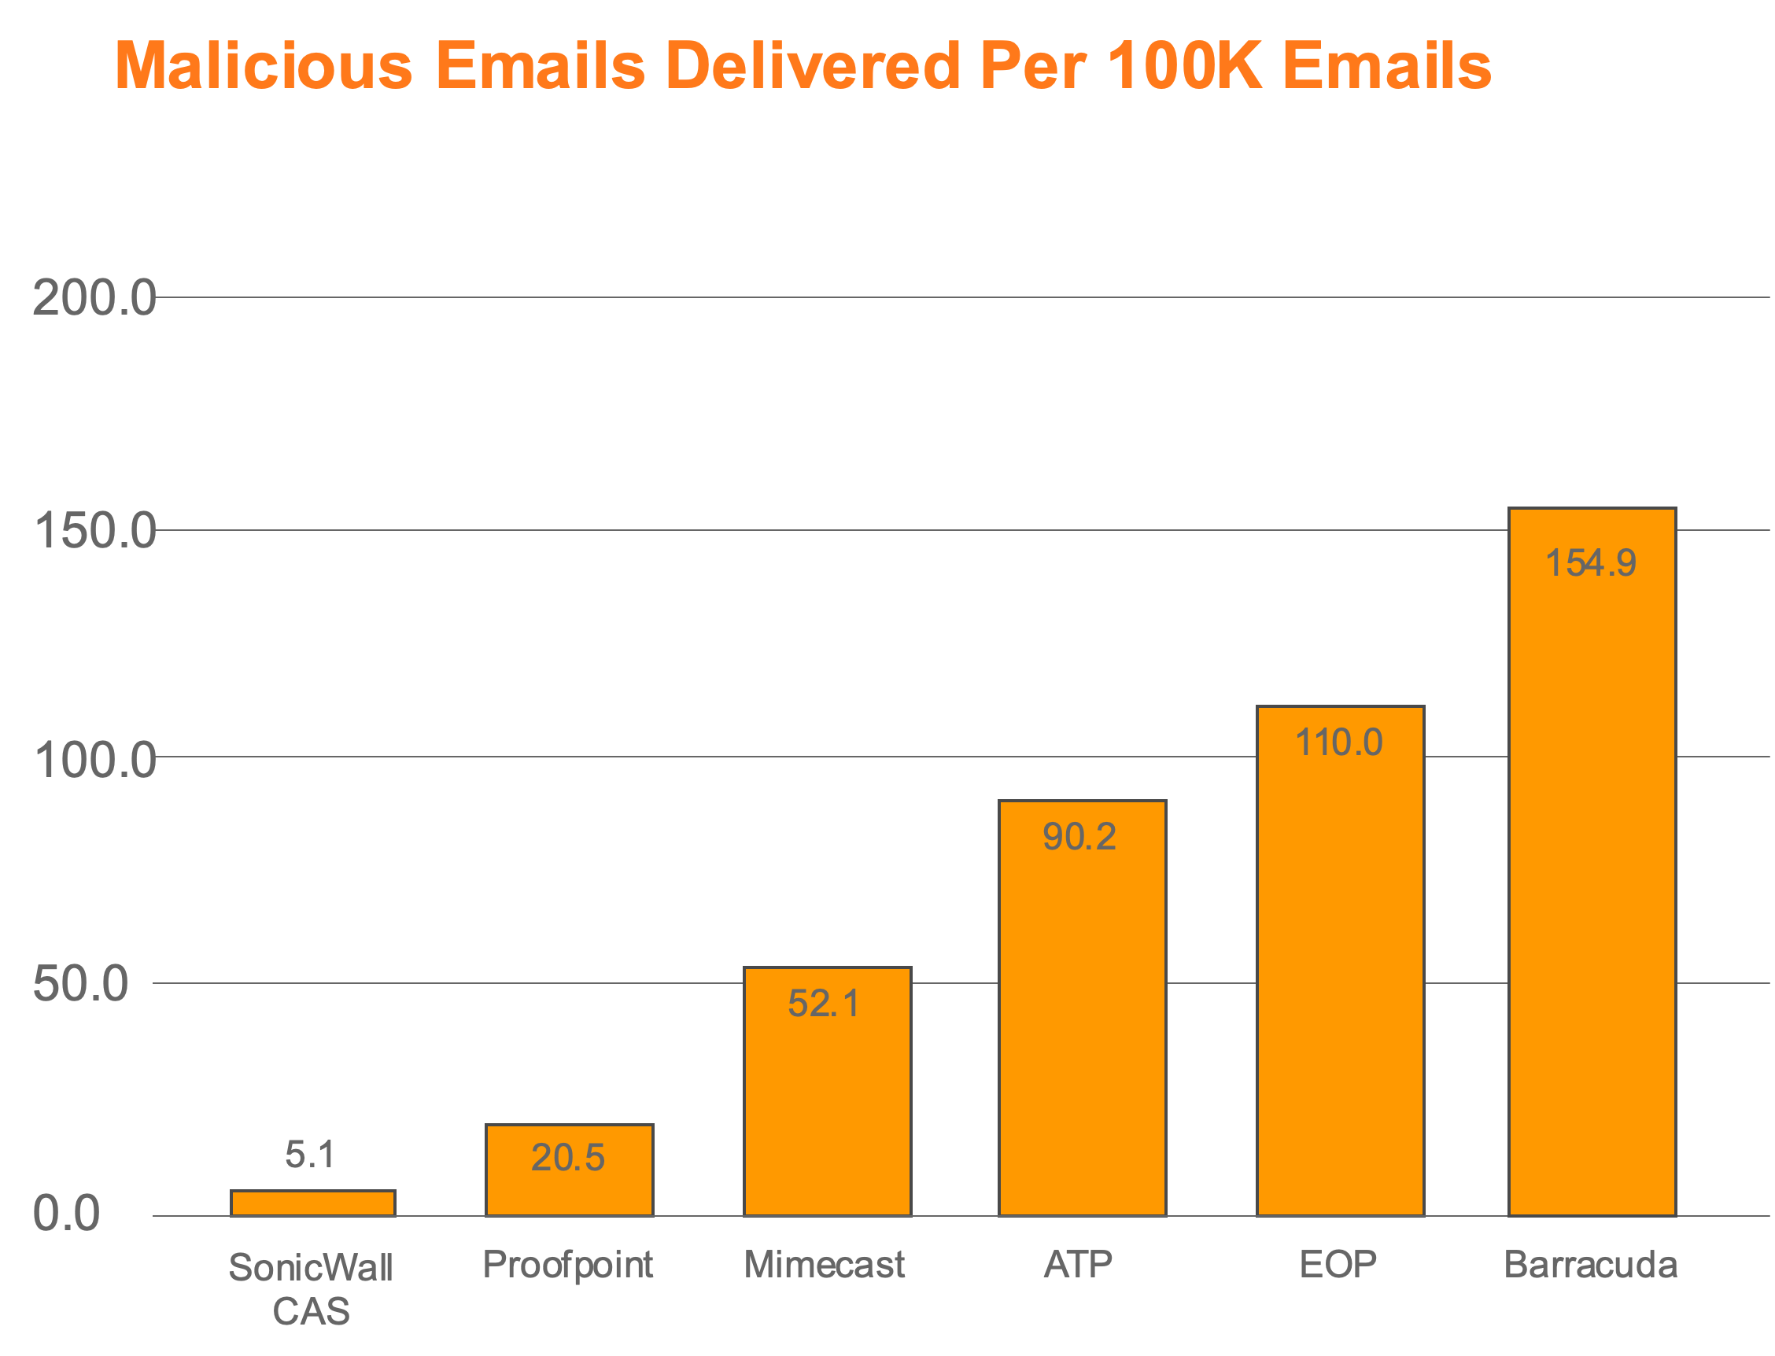
Research Study
360 Million Emails Analyzed
Measured the effectiveness of the most popular solutions in stopping attacks
CAS is:
15X more effective than Legacy Gateway approaches
18X more effective than Microsoft ATP

Slide 30
New Levels Of Cloud Visibility
We decided to do a trial with SonicWall CAS due to the increased pressure from regulators and auditors to have transparency into any cloud-based service.
After rolling it out, we immediately realized the potential of this product to ensure our data stayed safe in our Office 365 deployment.
It is now something that I actively use daily, allowing us to see who is logging into the system and who is changing files.
We can take preventative measures as we have seen some of our staff attempt to be hacked from other countries. Seeing this allowed us to implement MFA on all accounts affected by these hacking attempts.
It does a great job stopping phishing and junk mail from getting to our users.”
— Network Administrator, Small Business Financial Services Company

Slide 31
How SonicWall CAS Secures Microsoft 365 With APIs
Microsoft 365 Mail Environment
EOP
ATP
Multiple Threat Emulation Engines
Real-time threat feeds and URL analysis tools
Multiple anomaly and machine learning engines
Including CaptureATP and RTDMI
Notes:
<CLICK> CAS is API based, and does not require changing MX records, so in our case, we are invisible to attackers
SonicWall leverages its API access to the full Office 365 Suite in order to protect the environment. SonicWall employs multiple proprietary and third-party technologies to scan for phishing and malware in multiple ways:
After an Email is processed by EOP and ATP, <CLICK> We grab the message, hold on to it and scan it with multiple layers before releasing it to the inbox. <CLICK>
Inside our system, we use Multiple Threat Emulation Engines, <CLICK> including SonicWall’s Capture ATP, with RTDMI. More about that in a moment... <CLICK> These are Sandboxing tools to test every attachment to find Malware, both common variants and Never before seen threats<CLICK>
The Real Time threat feeds and URL analysis tools along with Natural language, anomaly detection and other algorithms identifies Phishing Emails <CLICK>
We also use a number of anomaly and ML engines. These engines have been developed to sit in O365 and are tuned to identify attacks that Microsoft misses. Some tuned on EOP misses, others exclusively for ATP misses. Additionally, there is another layer that is customized on a per-customer basis trained on that specific environment that identifies targeted threats against each specific organization for a customized response. <CLICK>

Slide 32
Notes:
Just recertified by ICSA LABS WITH A PERFECT SCORE
100% DETECTION AND 0 FALSE POSITIVES
THE TESTS
35 Days of Testing
1,471 Total Tests
580 New & Little-Known Samples
891 Innocuous Applications
THE RESULTS
100% Detection of Previously Unknown Threats
Zero False Positives
Fifth Consecutive ICSA Labs Certification

Slide 33
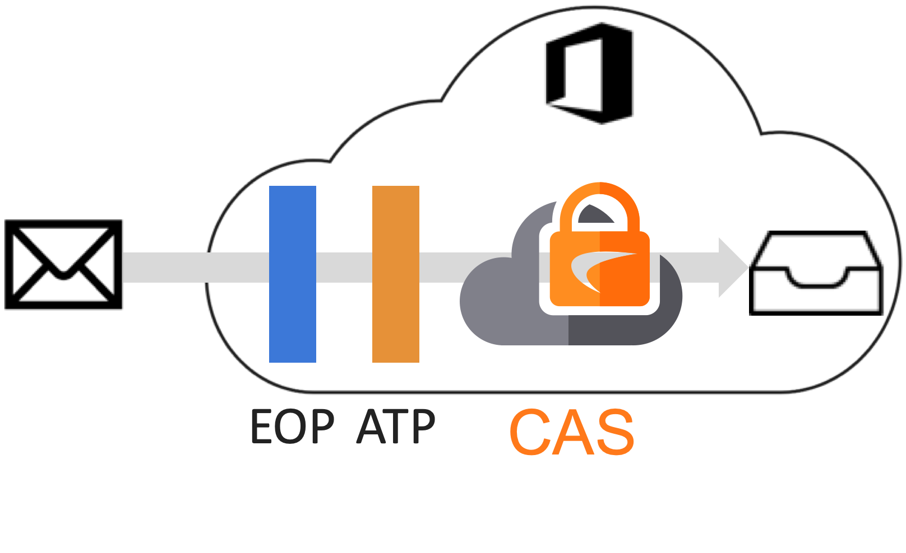
Cloud Application Security Architecture Benefits
CAS Architecture
Provides Customers
Embedded within O365 as a Layer
Last Line of Defense Before the Inbox
Built on Cloud APIs
Better Security
Saves More Time
Deploys in Minutes

Slide 34
How CAS Focused On Protecting Microsoft’s Weaknesses
Threat Emulation
Threat Feeds & URLs
ML and Anomaly
AI Engines Continuously Trained on Attacks That Evade Office 365
Dedicated Machine Learning Engine Tuned Per Customer
Analyzes 300+ Indicators of Phishing
Compromised Account Detection

Slide 35
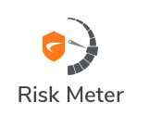
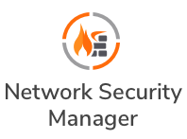
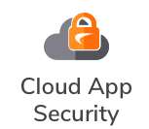
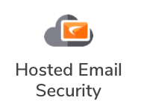
SonicWall Capture Cloud Platform Ecosystem
SonicWall
CAPTURE SECURITY CENTER
Firewall
Cloud SaaS
Wireless
Wireless Network
Manager
Cloud IaaS
Endpoint
IoT
Secure Access
Email
Notes:
SonicWall Capture Cloud Platform delivers a unified platform that can be leveraged across all SonicWall products with centralized management through Capture Security Center. <CLICK>This solution enhances network visibility as devices work together to share metrics, enabling cross-product traffic visibility. This enables to set more granular security policies to ensure protection from the most advanced attacks, providing connected security from a unified management console. It improves operational agility, manage risks, easily pass compliance checks and comply with audit requirements.

Slide 36
Next Steps
Sign up for a 30-Day CAS Trial
See what your current email protection misses
Notes:
Because of how we are deployed, without changing MX records but by inspecting Email threats as a last line, after Microsoft’s or Google’s layers of defenses or even a 3rd party MTA solution, a trial is a great way to evaluate the efficacy of your current solution. We can activate in a monitor only mode so that you can see first hand what we would act upon, and also see what got through your existing defenses.
Please submit a comment if you are interested in a trial.

Slide 37
Transparency & Security For Office 365
SonicWall has allowed our company to have transparency into our Office 365 deployment that other companies just don’t have in a package that is easy to deploy, manage and supervise. It has also allowed us to take advantage of our Office 365 deployment that we just would not have been able to do without this product. We are in a heavily regulated environment and need to have transparency into everywhere we store our data. SonicWall allows us to do that.
— Network Administrator, Small Business Financial Services Company

Slide 38
Q & A

